Slide 1
Canonical Cover
Notes:
1
The slides for this text are organized into chapters. This lecture covers Chapter 19, on formal, dependency-driven database design..
Integrity constraints, in particular functional dependencies, play an important role in the design of database schemas. In particular, they can shed light on potential redundancies (and the problems that go with redundancy) in a relational schema. Typically, they are used to analyze the relational schema obtained by converting an ER diagram.
This chapter can be covered any time after the Foundations material (Chapters 1 to 5) is covered, at the instructor’s discretion. A good choice is to cover it after presenting all the implementation related material that is included in a course. This will allow a design sequence consisting of Chapters 19 and 20, and will enable the instructor to bring out the fact that design involves both redundancy analysis and performance considerations, and that these concerns should go hand-in-hand.

Slide 2
Canonical Cover
To minimize FDs that need to be tested in case of any update, restrict F to F_{C}
System must rollback updates if FDs are violated
F logically implies all FDs in F_{c} and Vice versa
We can test these violations for simplified set of FDs that has the same closure as the given set

Slide 3
Canonical Cover
Sets of functional dependencies may have redundant dependencies that can be inferred from the others
  For example: A → C is redundant in: {A → B, B → C}
  Parts of a functional dependency may be redundant
    E.g.: on RHS: {A → B, B → C, A → CD} can be simplified to
    {A → B, B → C, A → D}
    E.g.: on LHS: {A → B, B → C, AC → D} can be simplified to
    {A → B, B → C, A → D}
Intuitively, a canonical cover of F is a “minimal” set of functional dependencies equivalent to F, having no redundant dependencies or redundant parts of dependencies

Slide 4
Equivalence of Sets of FDs
Two sets of FDs F and G are equivalent if:
- every FD in F can be inferred from G, &
- every FD in G can be inferred from F
Hence, F and G are equivalent if F⁺=G⁺
Definition: F covers G if every FD in G can be inferred from F
F and G are equivalent if F covers G and G covers F
There is an algorithm for checking equivalence of sets of FDs

Slide 5
Extraneous Attributes
Attribute is extraneous if we can remove it without changing closure of FDs
Consider a set F of functional dependencies and the functional dependency α → β in F
  Attribute A is extraneous in α if A ∈ α
  and F logically implies (F – {α → β}) ∪ {(α – A) → β}
  Attribute A is extraneous in β if A ∈ β
  and the set of functional dependencies
  (F – {α → β}) ∪ {α →(β – A)} logically implies F
Example: Given F = {A → C, AB → C }
  B is extraneous in AB → C because {A → C, AB → C} logically implies A → C (I.e. the result of dropping B from AB → C)
Example: Given F = {A → C, AB → CD}
  C is extraneous ? D is extraneous? (in AB→CD)

Slide 6
Testing if an Attribute is Extraneous
Consider a set F of functional dependencies over R and the functional dependency α → β in F
To test if attribute A ∈ α is extraneous in α
  compute ({α} – A)⁺ using the dependencies in F
  check that ({α} – A)⁺ contains β; if it does, A is extraneous in α
To test if attribute A ∈ β is extraneous in β
  compute α⁺ using only the dependencies in
  F’ = (F – {α → β}) ∪ {α →(β – A)},
  check that α⁺ contains A; if it does, A is extraneous

Slide 7
Canonical Cover
A canonical cover for F (a set of functional dependencies on a relational schema) is a set F_{C} of dependencies such that F logically
implies all dependencies in F _{C} , and F _{C} logically implies all dependencies in F
The set F _{C} has two important properties
  No functional dependency in F_{C} contains an extraneous attribut
  Each left side of a functional dependency in F_{C} is unique. That
  is, there are no two dependencies α₁ → β₁ and α₂ → β₂ in F_{C} such that α₁ = α₂
Both Fc and F have same closure

Slide 8
Canonical Cover
A canonical cover for F is a set of dependencies F_{c} such that
  F logically implies all dependencies in F_{c,} and
  F_{c} logically implies all dependencies in F, and
  No functional dependency in F_{c} contains an extraneous attribute, and
  Each left side of functional dependency in F_{c} is unique.
To compute a canonical cover for F:
F _{C} = F
repeat
Use the union rule to replace any dependencies in F
α₁ → β₁ and α₁ → β₂ with α₁ → β₁ β₂
Find a functional dependency α → β in F _{C} with an
extraneous attribute either in α or in β
If an extraneous attribute is found, delete it from α → β in F _{C} until (F _{C} does not change)
Note: Union rule may become applicable after some extraneous attributes have been deleted, so it has to be re-applied

Slide 9
Canonical Cover
To minimize the number of functional dependencies that need to be tested in case of an update we may restrict F to a canonical cover F_{c}

Slide 10
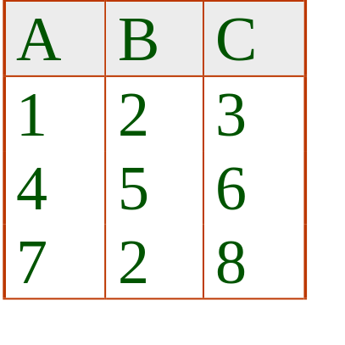
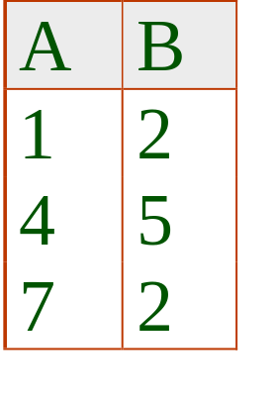
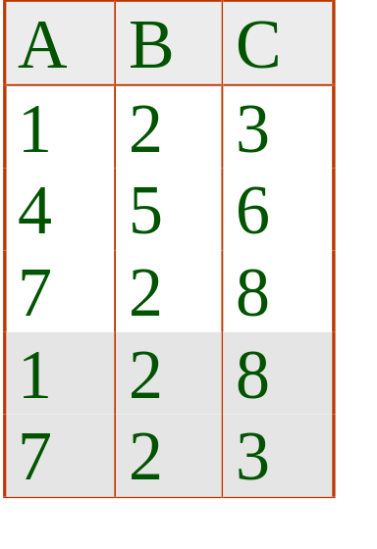
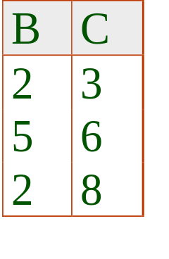
Lossy Decomposition
Note that we can never get anything less than the original relation
Since we don’t know which tuples are spurious and which are genuine, we have indeed lost information
Spurious Tuples
JOIN
Notes:
28

Slide 11
Lossy Decomposition
S# | Status | City
S3 | 30 | Paris
S5 | 30 | Athens
S# | Status
S3 | 30
S5 | 30
S# | City
S3 | Paris
S5 | Athens
1
2
S# | Status
S3 | 30
S5 | 30
Status | City
30 | Paris
30 | Athens
Notes:
28

Slide 12
Lossless Decomposition
Observe that S satisfies the FDs:
  S# ➔ Status & S# ➔ City
It is not a coincidence that S is equal to the join of its projections on {S#, Status} & {S#, City}
Heaths’ Theorem:
Let R{A,B,C} be a relation, where A, B, & C are sets of attributes. If R satisfies A➔B & A➔C, then R is equal to the join of its projections on {A,B} & {A,C}
Observe that in 2 the FD, S# ➔ City is lost
Notes:
28

Slide 13
Lossless Decomposition
The decomposition of R into R1, R2, …Rn is lossless if for any instance r of R
r = ∏_{R1} (r ) ∏_{R2} (r ) …… ∏_{Rn} (r )
We can replace R by R1 & R2, knowing that the instance of R can be recovered from the instances of R1 & R2
We can use FDs to show that decompositions are lossless
Notes:
28

Slide 14
Lossless Decomposition
Theorem
A decomposition of R into R1 and R2 is lossless join wrt FDs F, if and only if at least one of the following dependencies is in F⁺:
  R1 ∩ R2 → R1
  R1 ∩ R2 → R2
In other words, R1 ∩ R2 forms a superkey of either R1 or R2
Notes:
28

Slide 15
Lossless Decomposition
Dependency Preservation
Lossless decomposition is necessary
Losing a dependency (some FDs have to be checked using joins) adds to cost of checks during updates
Lossless dependency preserving decomposition
R (A B C) F = {A ->B, B ->C}
Decomposition of R: R1 (A C) R2 ( B C)
Is it dependency preserving?

Slide 16
Dependency Preservation
A Decomposition D = {R1, R2,……,Rm) is dependency preserving for set F if
    (F₁ ∪ F₂ ∪ … ∪ F_{m} )⁺ = F ⁺
    Where F_{i} means projection of set F onto R_{i}
    If it is not, then checking updates for violation of functional dependencies may require computing joins, which is expensive
    F_{i} = Π _{Ri} (F⁺) = { X→Y| {X,Y}⊆ R_{i} and X→Y ∈ F⁺ }

Slide 17
Dependency Preservation
Checking dependency preservation has exponential complexity (Subset calculation, 2^{n} subsets for set of size n)
Better if we could have the decomposition as dependency preserving in the first place (canonical cover F_{c})
F_{c} is the minimal set of FDs equivalent to F⁺
Two sets of FDs G and F are equivalent if G⁺ = F⁺ means G logically implies F and F logically implies G

Slide 18
Dependencies
R(A, B, C, D, E)
F = {A → D, B → E, DE → C}
Let S(A, B, C) be a decomposed relation of R. What FD-s do hold on S?

Slide 19
Testing for Dependency Preservation
To check if a dependency α → β is preserved in a decomposition of R into R₁, R₂, …, R_{n} we apply the following test (with attribute closure done with respect to F)
  result = α
  Repeat
  for each R_{i} in the decomposition
  t = (result ∩ R_{i})⁺ ∩ R_{i}
  result = result ∪ t
  Until(result does not change)
  If result contains all attributes in β, then the functional dependency
  α → β is preserved.
We apply the test on all dependencies in F to check if a decomposition is dependency preserving
This procedure takes polynomial time, instead of the exponential time required to compute F⁺ and (F₁ ∪ F₂ ∪ … ∪ F_{n})⁺

Slide 20
Dependency Preservation
Complexity of checking dependency preservation is exponential (subsets)
Decompose directly to dependency preserving decomposition

Slide 21
Dependency Preservation
The complexity of checking dependency preservation is exponential, since all the subsets must be calculated, and the number of subsets of an n-elements set is 2^{n}

